Slide 1
Advanced Design Methods (MDO)
MDO Practical session 1
An overview on the Matlab function fmincon for gradient based optimization
AE4233
D.Steenhuizen@tudelft.nl
A.Elham@tudelft.nl
G.Larocca@tudelft.nl
FPP

Slide 2
Overview
The Matlab Fmincon function for gradient-based constrainted optimisation

Slide 3
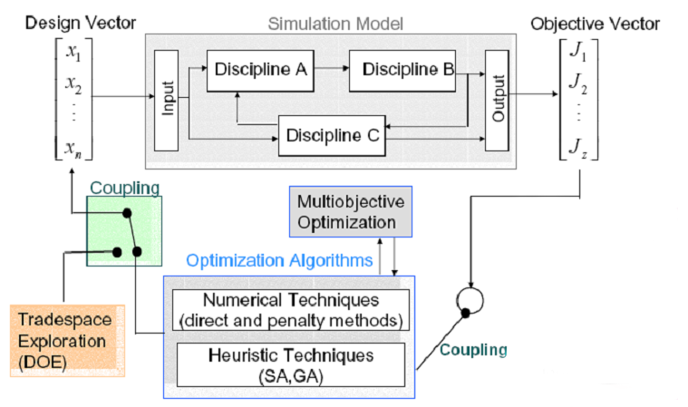
Optimization algorithms
1

Slide 4
Fmincon-routine. Main characteristics
The Matlab Fmincon routine tries to minimize the input objective function, whilst respecting a set of linear and / or nonlinear input constraints.
Fmincon is a gradient based routine, therefore its outcome has potentially a strong dependence on the initial-guess design-vector. It is prone to terminate its search in a local, rather than the global optimum
Fmincon is a single-objective routine, it can find a (local) optimum design-vector of any given dimension, but the objective function itself should always return a simple scalar value.

Slide 5
Fmincon input
Fmincon can be opened in Matlab with the following input-line:
x_{opt} = fmincon(fun,x0,A,b,A_{eq},b_{eq},lb,ub,nonlcon,options)

Slide 6
Fmincon input
Fmincon can be opened in Matlab with the following input-line:
x_{opt} = fmincon(fun,x0,A,b,A_{eq},b_{eq},lb,ub,nonlcon,options)
- x_{opt} output minimized design-vector
fun function to minimize, enter with function-handle: “@Aero_CST”
x0 starting or initial-guess vector , should have the same dimension as the design-vector x
lb lower bound (vector) to search-space of x, should have same dimension as x
ub upper bound (vector) to search-space of x, should have same dimension as x

Slide 7
Fmincon input
Fmincon can be opened in Matlab with the following input-line:
x_{opt} = fmincon(fun,x0,A,b,A_{eq},b_{eq},lb,ub,nonlcon,options)
- x_{opt} output minimized design-vector
fun function to minimize, enter with function-handle: “@Aero_CST”
x0 starting or initial-guess vector , should have the same dimension as the design-vector x
lb lower bound (vector) to search-space of x, should have same dimension as x
ub upper bound (vector) to search-space of x, should have same dimension as x
This is the minimum required input for Fmincon:
x = fmincon(fun,x0,[-],[-],[-],[-],lb,ub,[-],[-])

Slide 8
Fmincon linear constraints
x_{opt} = fmincon(fun,x0,A,b,A_{eq},b_{eq},lb,ub,nonlcon,options)
Linear inequality constraints:
A x ≤ b
Linear equality constraints:
A_{eq} x = b_{eq}

Slide 9
Fmincon linear constraints
x_{opt} = fmincon(fun,x0,A,b,A_{eq},b_{eq},lb,ub,nonlcon,options)
Linear inequality constraints:
A x ≤ b
Linear equality constraints:
A_{eq} x = b_{eq}
Fmincon
Current objective value
Routine to determine next search design point
Next analysis search vector
A x ≤ b
A_{eq} x = b_{eq}

Slide 10
Fmincon nonlinear constraints
x_{opt} = fmincon(fun,x0,A,b,A_{eq},b_{eq},lb,ub,nonlcon,options)
enter with function-handle: “@Aero_CST_nonlcon”
Fmincon
Routine to determine next search design point
x
x feasible
F_{nonlin-con}(x)
x not feasible

Slide 11
Fmincon optimization options
x_{opt} = fmincon(fun,x0,A,b,A_{eq},b_{eq},lb,ub,nonlcon,options)
The optimization options for Fmicon are set in the “options” variable with optimset:
options = optimset(‘DiffMaxChange’, 0.1, ‘DiffMinChange’, 0.001, ‘MaxIter’, 150, … )
DiffMaxChange Maximum change in variables for finite differencing
DiffMinChange Minimum change in variables for finite differencing*
FunValCheck Check whether objective function values are valid. 'on' displays a warning when the objective function returns a value that is complex, Inf, or NaN. 'off' displays no warning.
MaxFunEvals Maximum number of function evaluations allowed
MaxIter Maximum number of iterations allowed
OutputFcn Specify a user-defined function that an optimization function calls at each iteration. See Output Function.
TolFun Termination tolerance on the function value.
TolCon Termination tolerance on the constraint violation.
TolX Termination tolerance on x
Notes:
Use DiffMinChange to set the minimum perturbation for finite differencing in order to determine Jacobian information. Consider revising when there is a low sensitivity of the objective function w.r.t. a design-variable.
All settings for Fmincon’s options have a default-value, which will be used unless you overwrite them.
MaxFunEvals, MaxIter, TolFun, TolCon, TolX: use these options to set the terminations criteria for the current optimization-problem.
OutputFcn: a user defined output-function that is called at each function evaluation, e.g. plot current input design.
Note that the MatLab help-index for ‘optimset’ lists a complete table with all possible options to be set for Fmincon.

Slide 12
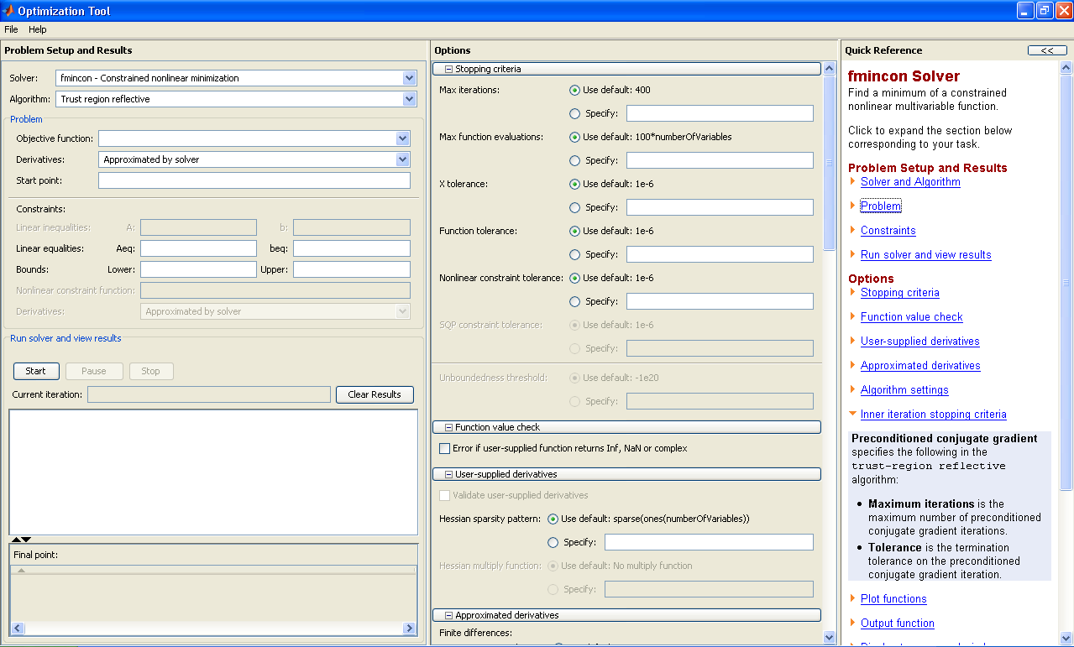
Implementation of optimization-routines via GUI (optimtool)
Matlab has a dedicated graphical user interface (GUI) for all its optimisation routines. Type “optimtool” at the command-line to invoke it.

Slide 13
Implementation of optimization-routines via code-lines
Although the optimtool GUI is very illustrative, for application in an MDO-problem, the regular code-lines for these routines should be used, e.g.:
x = fmincon(fun,x0,A,b,A_{eq},b_{eq},lb,ub,nonlcon,options)
This is because the GUI can only invoke 1 optimization, which is not enough for a multi-level approach or any other approach making use of more optimizations

